Slide 1
“Tap & Buy”
Transitioning
From Physical Store
To Online Shop
L02 Group 8
Wong Ka Ho, Isaac (54816829)
Wong Ho Kit, Kit(55774069)
Chan Tsz Fung, Frank (56034618)

Slide 2
abstract
Motivation of the project
Introduction of the system
Benefits of the system created for the customer and store
Brief function of the system
Reflection in whole system designation

Slide 3



Aims
The new coronavirus outbreak is continuing
Numerous stores are closures or shutdowns
Revenue and Cost
Physical Store to Online Shop
Store
Cost
Storehouse and Shipment
Provide compromise solutions to stores
“Tap & Buy”

Slide 4



Introduction
“Tap & Buy”
Unmanned self-help cashier
Combine Physical Store and Online Shop
Using online shop website/app to choose product
Customer finish the trade in the Physical Store
Identify
Payment
Local pickup

Slide 5

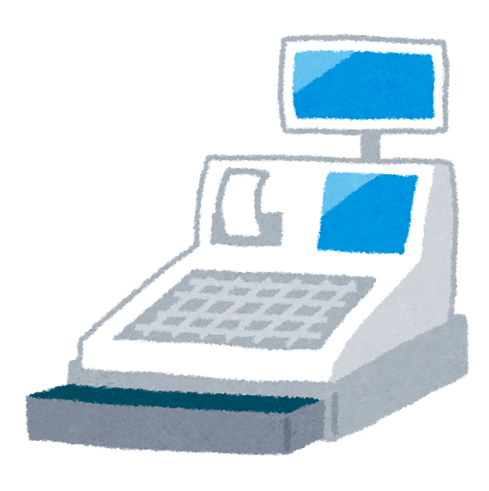


Scenario
Tap & Buy

Slide 6
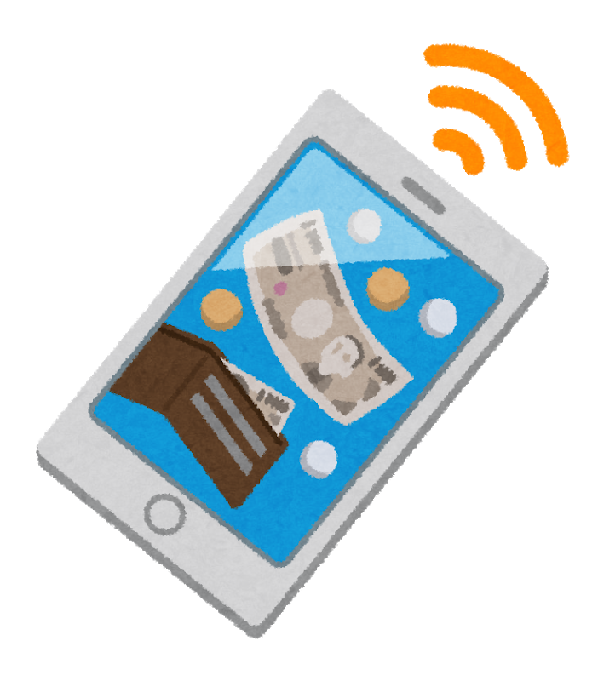





Scenario

Slide 7
Benefit
-Increase space utilization
-Reduce labor expenses
-Reduce the service time of customers
-Epidemic prevention

Slide 8
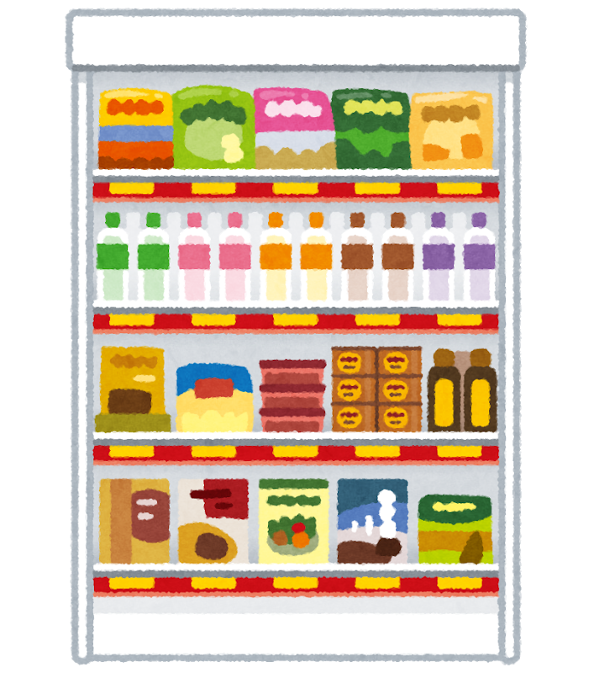
Increase Space utilization
Reduce the number of display shelves in the shop
Increase the variety of product
Attract more customers

Slide 9

Reduce labor expenses
Less shopkeeper to maintain daily operation
Less injuries is likely to happen
Lower cost to run

Slide 10

Reduce the service time
The customers already had a shopping list
No need to looking for the product in the shop
Higher flow rate for the customer
Higher income

Slide 11

Epidemic prevention
Reduce the time of customer staying
No direct contact between the products and customers
Less face-to-face interaction between the customers and shopkeepers

Slide 12
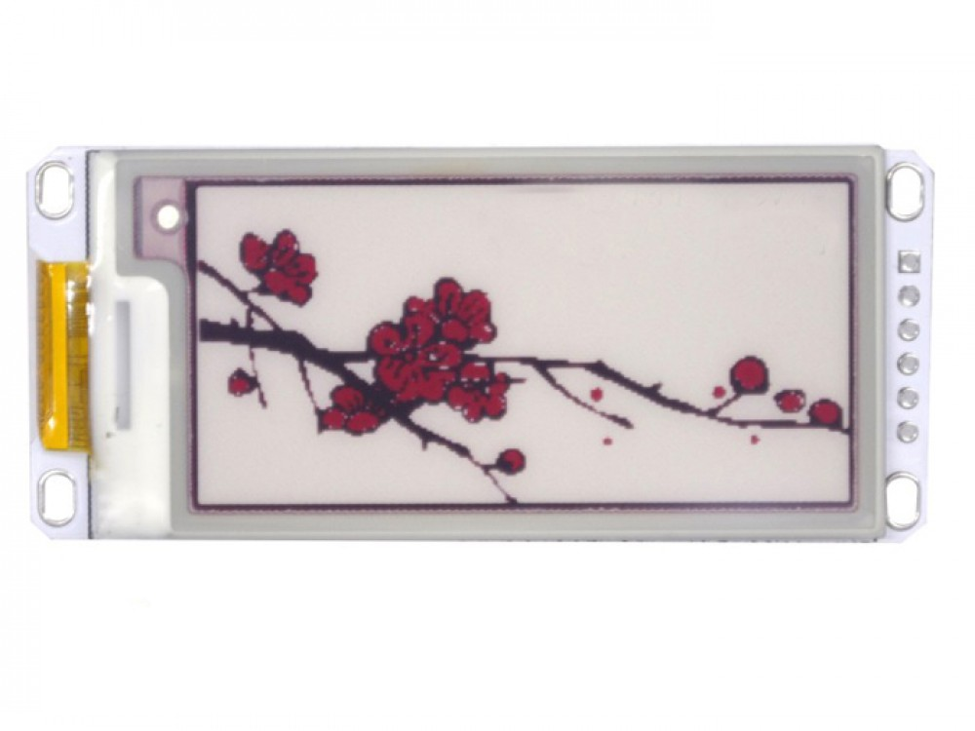


Structure of the product
Human-machine interaction
Authentication
User interface
Data Management & Network communication

Slide 13

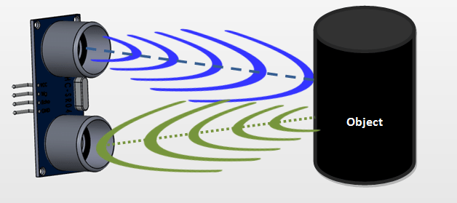
Human-machine interaction
Ultrasonic sensor sense the customer and drive the system
Decrease the consuming power
Display greeting and request customer tap the card on OLED
Guide the customer to use the system

Slide 14


Authentication
Customer tap the card on RFID
RFID will get the unique ID from card
Send it to database and match
Display corresponding data on OLED
All the personal information will be encrypted
Ensure the confidentiality of the data

Slide 15


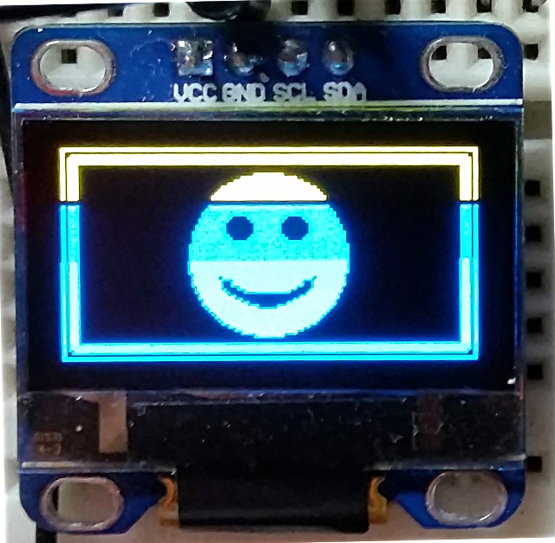
User interface
OLED will display the product list
User can confirm the product quantity by OLED display broad
Change the number of product by clicking the button at will

Slide 16



Data Management &
Network communication
All the data will sent via WiFi
Data will store it the database system
Sort the data when received a new data from arduino
Update the inventory after every service

Slide 17


conclusion
“Tab & Buy” is Unmanned self-help cashier aims for increase space utilization, reduce labor expenses & service time of customers and prevent Epidemic
“Tab & Buy” provide a safety and reliable system with user-friendly interface.

Slide 18

reflection
We learnt how to design a technical product under the view of customer and businessman.
A simple login system requires a lot of logical thinking to clear out the bugs.

Slide 19
End

